Slide 1

Database Lecture 9
Relational Design
Functional Dependencies
Addendum
Dr. Jefferson Fong
Reference 7.4

Slide 2
Reminder
Project ER diagrams are due on Sun 23 Nov, right before midnight.
Project Static Webpages (HTML files) are due on Sun 30 Nov, right before midnight.
Concepts of FD are complicated; the Addendum is almost as long as the lecture!
  I hope the extra explanations help.

Slide 3
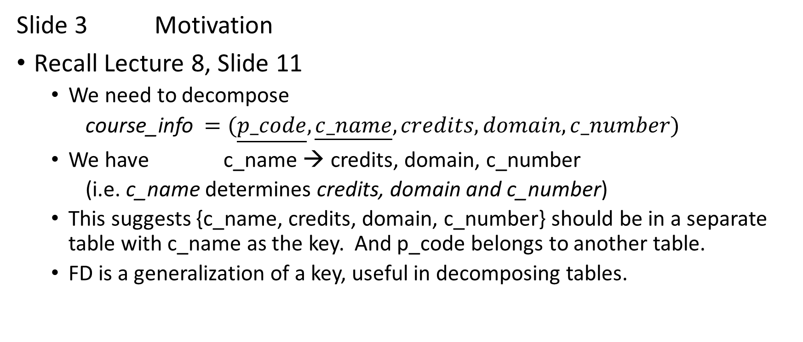
Functional Dependency (FD)
Slide 3 Motivation
Recall Lecture 8, Slide 11
  We need to decompose
  course_info $=(\underline{p_code},\underline{c_name},credits,domain,c_number$)
  We have c_name → credits, domain, c_number
    (i.e. c_name determines credits, domain and c_number)
  This suggests {c_name, credits, domain, c_number} should be in a separate table with c_name as the key. And p_code belongs to another table.
  FD is a generalization of a key, useful in decomposing tables.

Slide 4
Side 4 Motivation on Functional Dependency (FD)
Mathematically we express tuples (X, Y, Z) in the rows of a table.
  In DB table, we should not have duplicate rows.
Consider the function Y=f(X).
X | Y | Z
1 | 10 | 100
1 | 10 | 200
X | Y | Z
1 | 10
1 | 11
In left table,
  Y=f(X) is a function; f(1) = 10 in both rows.
  FD X determines Y, written as X → Y.
In right table,
  Y is not a function of X; f(1) = 10 in row 1, but f(1) = 11 in row 2.
  X does not determine Y; we don’t have X → Y

Slide 5
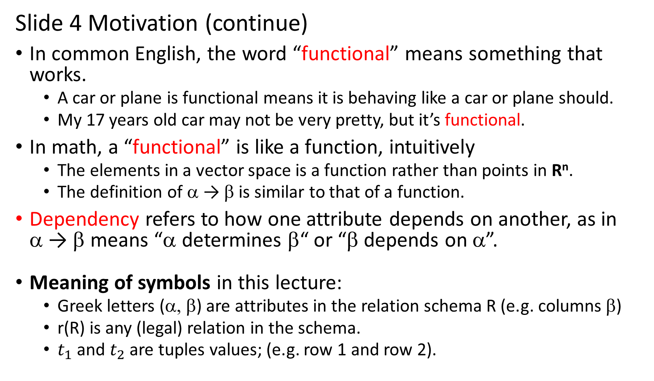
Slide 4 Motivation (continue)
In common English, the word “functional” means something that works.
  A car or plane is functional means it is behaving like a car or plane should.
  My 17 years old car may not be very pretty, but it’s functional.
In math, a “functional” is like a function, intuitively
  The elements in a vector space is a function rather than points in R^{n}.
  The definition of α → β is similar to that of a function.
Dependency refers to how one attribute depends on another, as in α → β means “α determines β“ or “β depends on α”.
Meaning of symbols in this lecture:
  Greek letters (α, β) are attributes in the relation schema R (e.g. columns β)
  r(R) is any (legal) relation in the schema.
  $t_{1}$ and $t_{2}$ are tuples values; (e.g. row 1 and row 2).

Slide 6
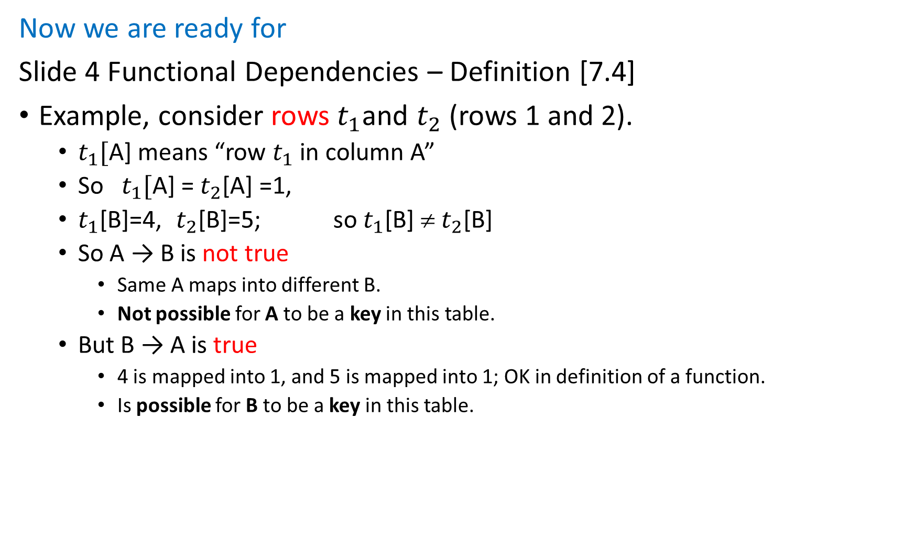
Now we are ready for
Slide 4 Functional Dependencies – Definition [7.4]
Example, consider rows${ t}_{1}$and $t_{2}$ (rows 1 and 2).
  $t_{1}[$A] means “row $t_{1}$ in column A”
  So $t_{1}[$A] = $t_{2}$[A] =1,
  $t_{1}$[B]=4, $t_{2}$[B]=5; so $t_{1}$[B] ≠ $t_{2}$[B]
  So A → B is not true
    Same A maps into different B.
    Not possible for A to be a key in this table.
  But B → A is true
    4 is mapped into 1, and 5 is mapped into 1; OK in definition of a function.
    Is possible for B to be a key in this table.

Slide 7
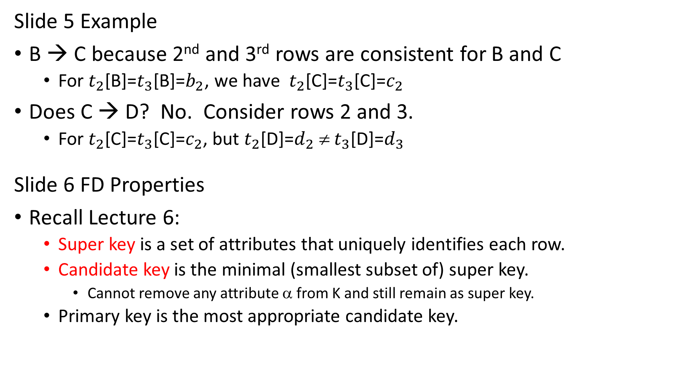
Slide 5 Example
B → C because 2nd and 3rd rows are consistent for B and C
  For $t_{2}$[B]=$t_{3}$[B]=$b_{2}$, we have $t_{2}$[C]=$t_{3}$[C]=$c_{2}$
Does C → D? No. Consider rows 2 and 3.
  For $t_{2}$[C]=$t_{3}$[C]=$c_{2}$, but $t_{2}$[D]=$d_{2}$ ≠ $t_{3}$[D]=$d_{3}$
Slide 6 FD Properties
Recall Lecture 6:
  Super key is a set of attributes that uniquely identifies each row.
  Candidate key is the minimal (smallest subset of) super key.
    Cannot remove any attribute α from K and still remain as super key.
  Primary key is the most appropriate candidate key.

Slide 8
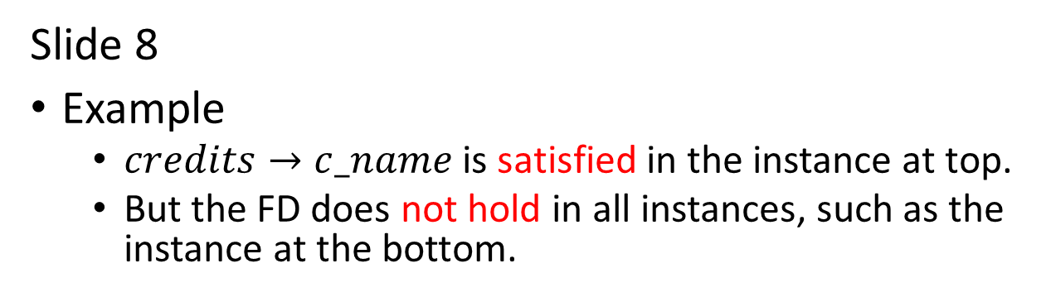
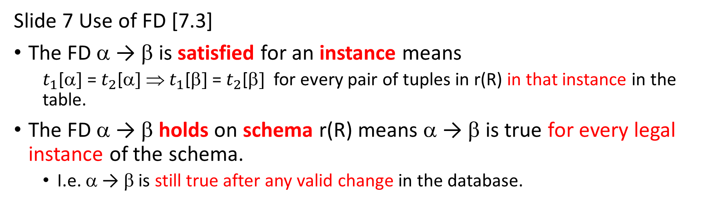
Slide 7 Use of FD [7.3]
The FD α → β is satisfied for an instance means
  $t_{1}$[α] = $t_{2}$[α] ⇒ $t_{1}$[β] = $t_{2}$[β] for every pair of tuples in r(R) in that instance in the table.
The FD α → β holds on schema r(R) means α → β is true for every legal instance of the schema.
  I.e. α → β is still true after any valid change in the database.
credit | c_name
3 | DBMS
1 | Workshop 1
Slide 8
Example
  $credits→c_name$ is satisfied in the instance at top.
  But the FD does not hold in all instances, such as the instance at the bottom.
credit | c_name
3 | DBMS
3 | Software Enineering

Slide 9
Slide 9
These FD are trivial:
{A, B} → {A}, and {A} → {A}

Slide 10
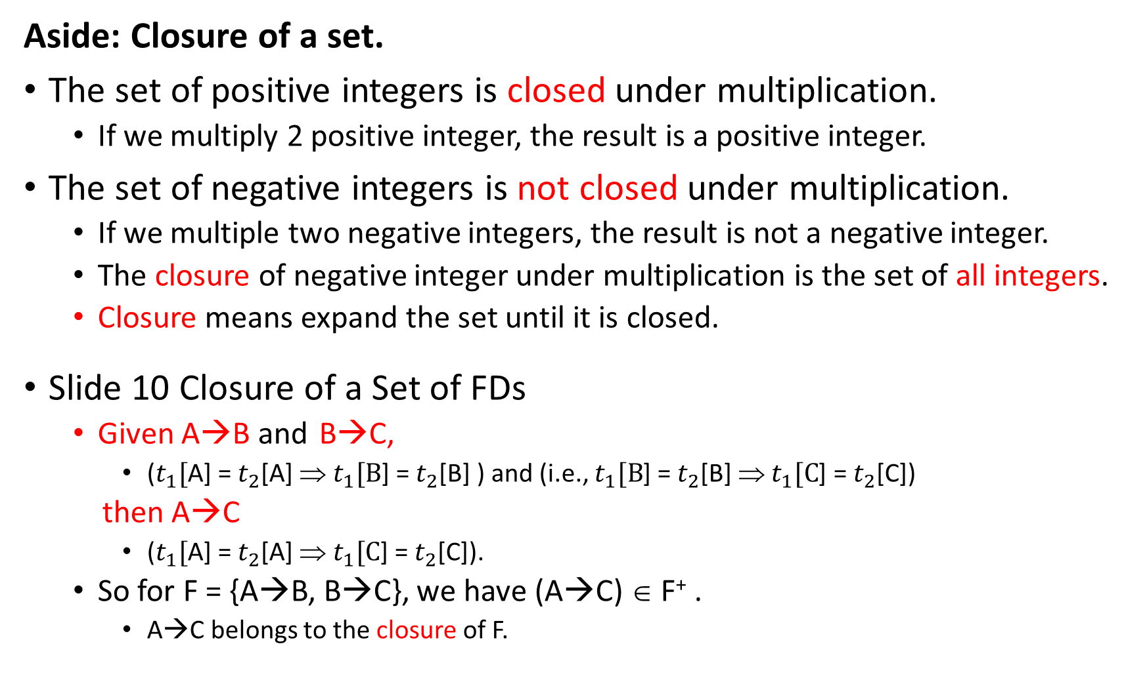
Aside: Closure of a set.
The set of positive integers is closed under multiplication.
  If we multiply 2 positive integer, the result is a positive integer.
The set of negative integers is not closed under multiplication.
  If we multiple two negative integers, the result is not a negative integer.
  The closure of negative integer under multiplication is the set of all integers.
  Closure means expand the set until it is closed.
Slide 10 Closure of a Set of FDs
  Given A→B and B→C,
    ($t_{1}[$A] = $t_{2}$[A] ⇒ $t_{1}[B$] = $t_{2}$[B] ) and (i.e., $t_{1}[B$] = $t_{2}$[B] ⇒ $t_{1}[C$] = $t_{2}$[C])
  then A→C
    ($t_{1}[$A] = $t_{2}$[A] ⇒ $t_{1}[C$] = $t_{2}$[C]).
  So for F = {A→B, B→C}, we have (A→C) ∈ F⁺ .
    A→C belongs to the closure of F.

Slide 11
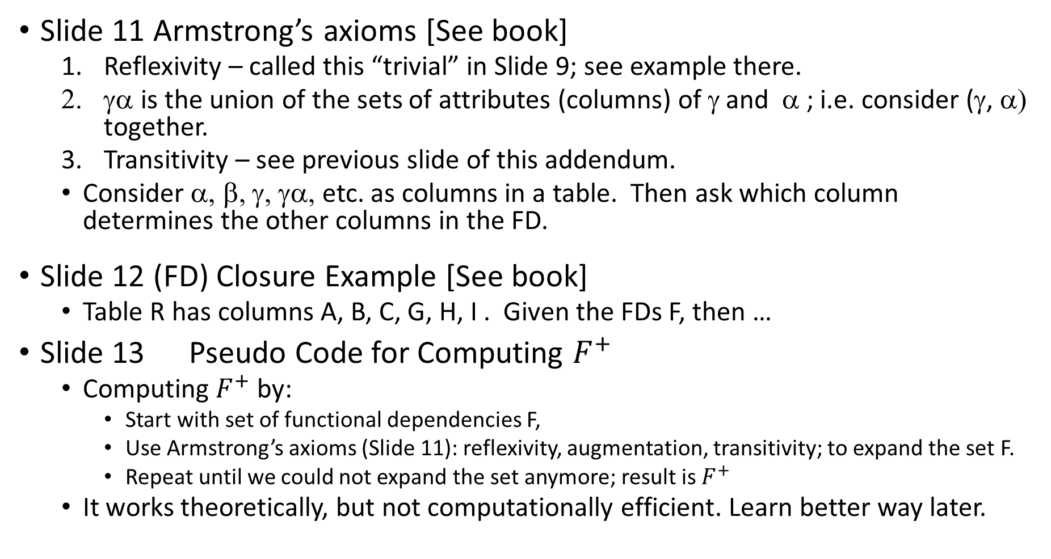
Slide 11 Armstrong’s axioms [See book]
  Reflexivity – called this “trivial” in Slide 9; see example there.
  γα is the union of the sets of attributes (columns) of γ and α ; i.e. consider (γ, α) together.
  Transitivity – see previous slide of this addendum.
  Consider α, β, γ, γα, etc. as columns in a table. Then ask which column determines the other columns in the FD.
Slide 12 (FD) Closure Example [See book]
  Table R has columns A, B, C, G, H, I . Given the FDs F, then …
Slide 13 Pseudo Code for Computing $F^{+}$
  Computing $F^{+}$ by:
    Start with set of functional dependencies F,
    Use Armstrong’s axioms (Slide 11): reflexivity, augmentation, transitivity; to expand the set F.
    Repeat until we could not expand the set anymore; result is $F^{+}$
  It works theoretically, but not computationally efficient. Learn better way later.

Slide 12
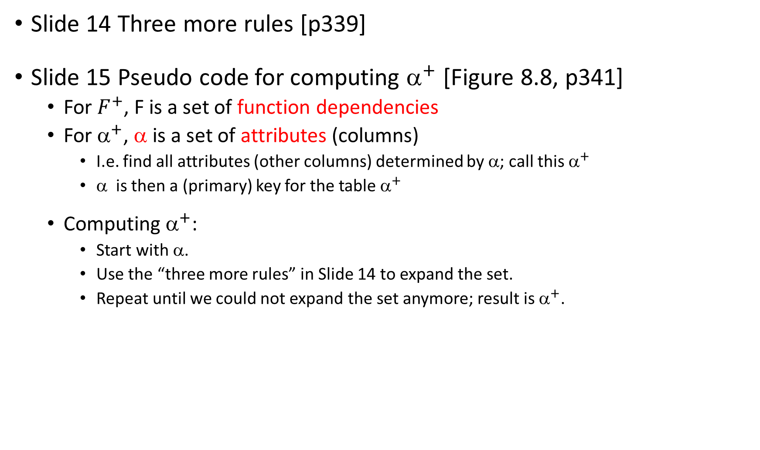
Slide 14 Three more rules [p339]
Slide 15 Pseudo code for computing ${\text{a}}^{+}$ [Figure 8.8, p341]
  For $F^{+}$, F is a set of function dependencies
  For ${\text{a}}^{+}$, α is a set of attributes (columns)
    I.e. find all attributes (other columns) determined by α; call this ${\text{a}}^{+}$
    α is then a (primary) key for the table ${\text{a}}^{+}$
  Computing ${\text{a}}^{+}$:
    Start with α.
    Use the “three more rules” in Slide 14 to expand the set.
    Repeat until we could not expand the set anymore; result is ${\text{a}}^{+}$.

Slide 13
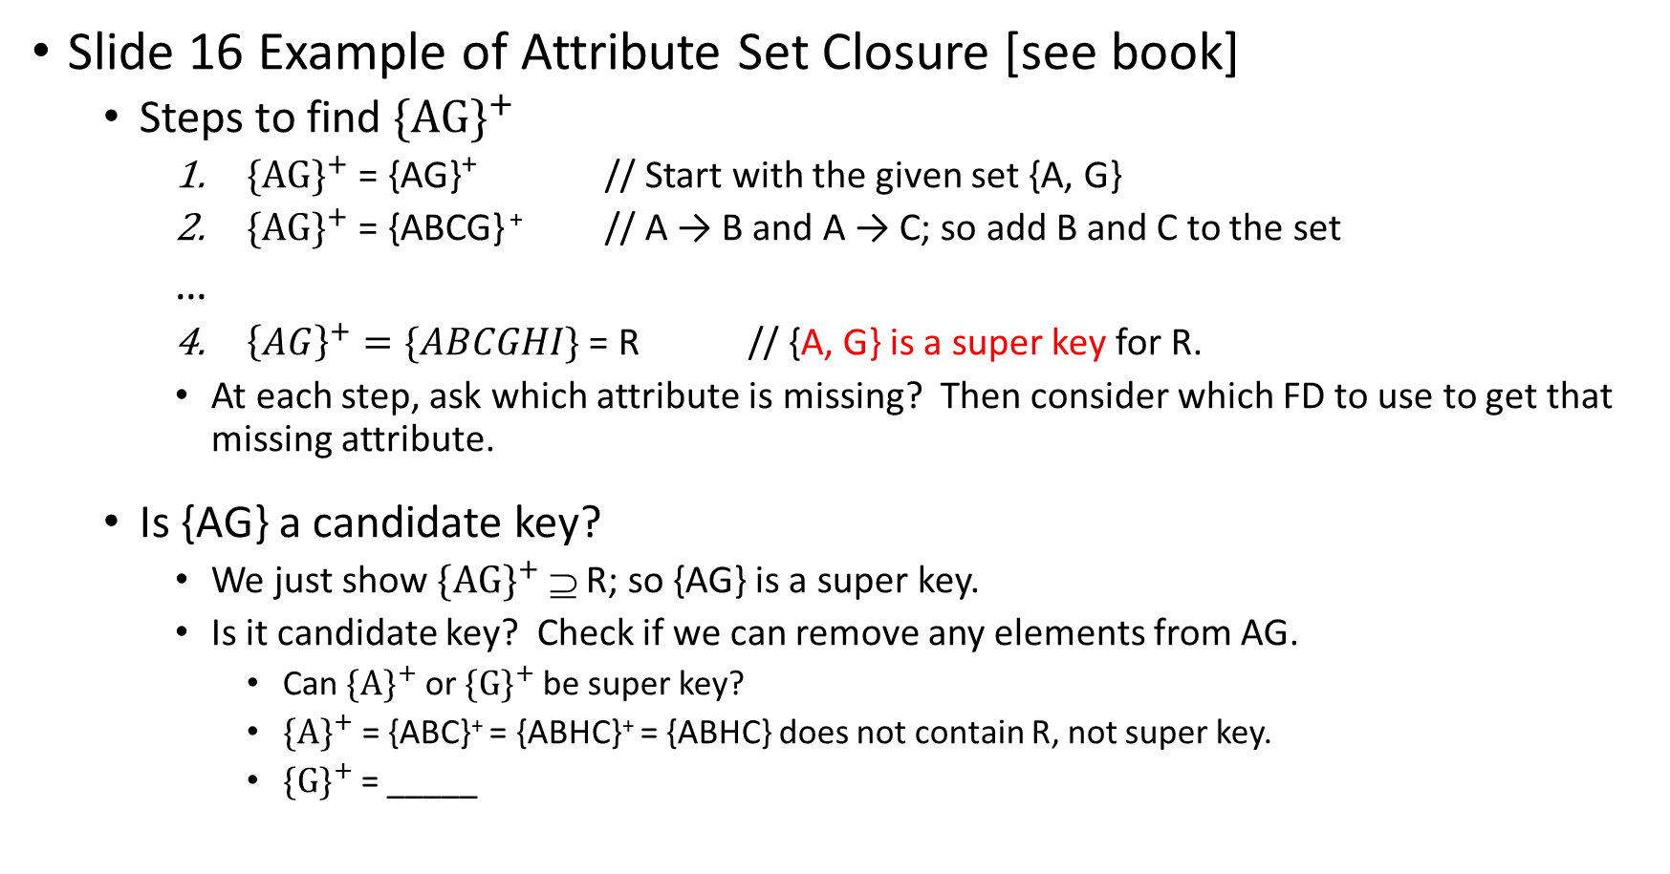
Slide 16 Example of Attribute Set Closure [see book]
  Steps to find ${\{AG\}}^{+}$
    ${\{AG\}}^{+}$ = {AG} ⁺ // Start with the given set {A, G}
    ${\{AG\}}^{+}$ = {ABCG} ⁺ // A → B and A → C; so add B and C to the set
  …
    ${\left\{AG\right\}}^{+}=\{ABCGHI\}$ = R // {A, G} is a super key for R.
    At each step, ask which attribute is missing? Then consider which FD to use to get that missing attribute.
  Is {AG} a candidate key?
    We just show ${\{AG\}}^{+}$ ⊇ R; so {AG} is a super key.
    Is it candidate key? Check if we can remove any elements from AG.
      Can ${\{A\}}^{+}$ or ${\{G\}}^{+}$ be super key?
      ${\{A\}}^{+}$ = {ABC}⁺ = {ABHC}⁺ = {ABHC} does not contain R, not super key.
      ${\{G\}}^{+}$ = _____
Notes:
${\{G\}}^{+}$ = {G} not a super key. So {AG} is a candidate key.

Slide 14
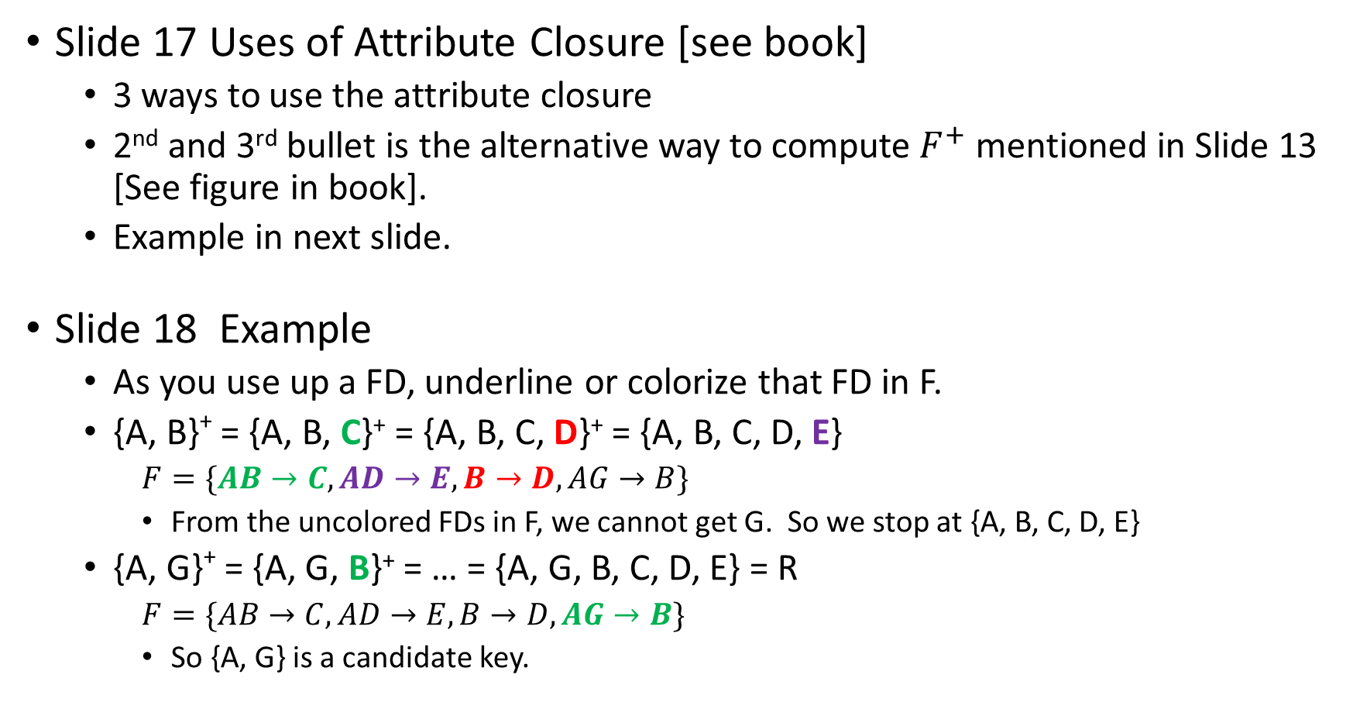
Slide 17 Uses of Attribute Closure [see book]
  3 ways to use the attribute closure
  2nd and 3rd bullet is the alternative way to compute $F^{+}$ mentioned in Slide 13 [See figure in book].
  Example in next slide.
Slide 18 Example
  As you use up a FD, underline or colorize that FD in F.
  {A, B}⁺ = {A, B, C}⁺ = {A, B, C, D}⁺ = {A, B, C, D, E}
    $F=\{AB→C,AD→E,B→D,AG→B\}$
    From the uncolored FDs in F, we cannot get G. So we stop at {A, B, C, D, E}
  {A, G}⁺ = {A, G, B}⁺ = … = {A, G, B, C, D, E} = R
    $F=\{AB→C, AD→E,B→D,AG→B\}$
    So {A, G} is a candidate key.

Slide 15
Lab 09
If time permits, lecture a few slides.

